Slide 1
Modern Web Technologies Week 3 – Intro to Express
Instructor: Harman Mann

Slide 2
Agenda
What is Express and why we use it
Frameworks
How to create an express server
NPM scripting
Express router
Express Middleware

Slide 3
What is Express
Framework for Node.js
Fast, unopinionated, minimalist
Server-side framework
Used in combination with front-end frameworks to build full-stack applications
Express.js is a modular web framework for Node.js. It is used for easier creation of web applications and services

Slide 4
How does it work?
Express provides
methods to specify what function is called for a particular HTTP verb (GET, POST, UPDATE, DELETE)
and URL pattern ("Route"),
and methods to specify what template ("view") engine is used,
where template files are located, and what template to use to render a response

Slide 5
What is a Framework
A pre-Built set of tools, libraries and conventions that provide a structured way to build and organizes web apps
They help streamline development process
They include giving developers' functionalities, design patterns and best practices
Frameworks breakdown into 2 categories: Front end and Back end

Slide 6
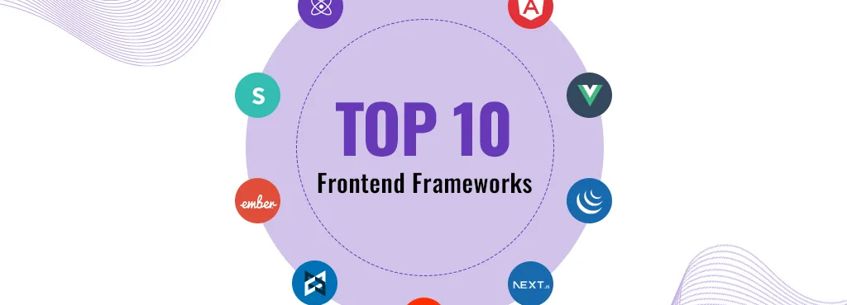

Front End Frameworks
Next, React, Angular, and Vue
Render content to the user
Communicates with back-end framework through HTTP
Send form data, file uploads, and JSON formatted data
https://blog.stackademic.com/the-ultimate-frontend-frameworks-for-development-2024-edition-2df65997c52f

Slide 7
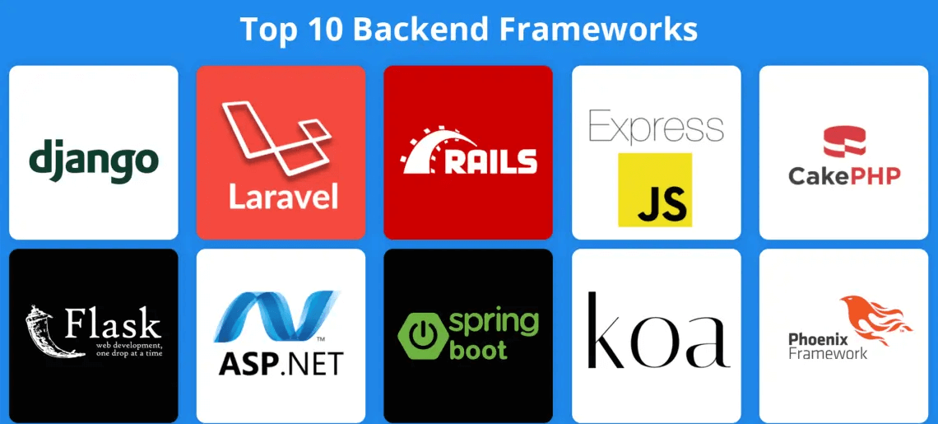
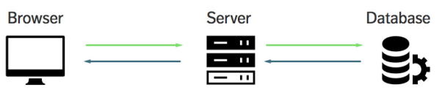
Back End Frameworks
Accept requests and data from the front-end
Sanitize and process the data
Authentication and authorization
Store and fetch data from database
Top 10 Backend Frameworks in 2024: Features, Benefits & Uses

Slide 8
NPM Scripting
Since we are using Express, a framework NOT built in to node we need to install the packages for it
In a terminal: npm install express

Slide 9
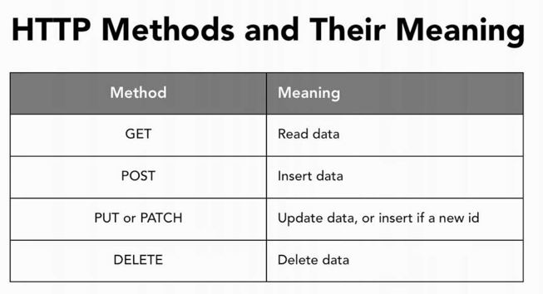
Express Routing
Talk about this

Slide 10
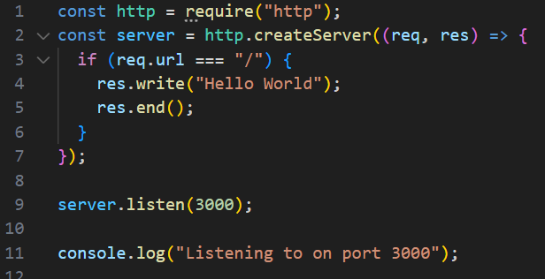
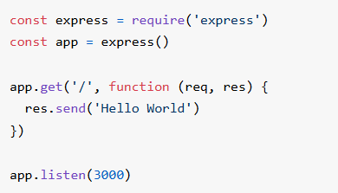
Node vs Express
Node server
Express server

Slide 11
Express Routing
Express makes handling routes more simplified
Can load pages, fetch data from database, and return JSON
app.get(), app.post(), app.put(), app.delete()
Access to request, response, parameters, query strings, and url components
Express includes a router so routes can be stored in separate files
Parse incoming data with body parser

Slide 12
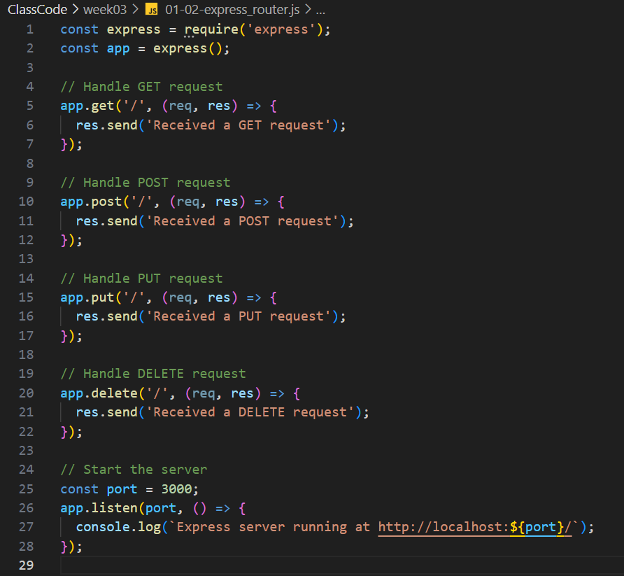
How to use Routing Methods
Routing is broken down into 2 parts
1 – the route
2 – the method
A ‘route’, as mentioned before, is a path on your site that can have requests sent to it, and respond from it (an endpoint).
Each route gets registered with express ‘routers’ and has callback functions that get called when a request to that route is made
app.get(endpoint, callback)

Slide 13
Routing Method Examples
I will showcase 3 examples here (we will do some things during the lab)
1 – A node server example (Lab 1, Part 2)
2 – an express server example (Todays Class)
3 – another express server example with chaining

Slide 14
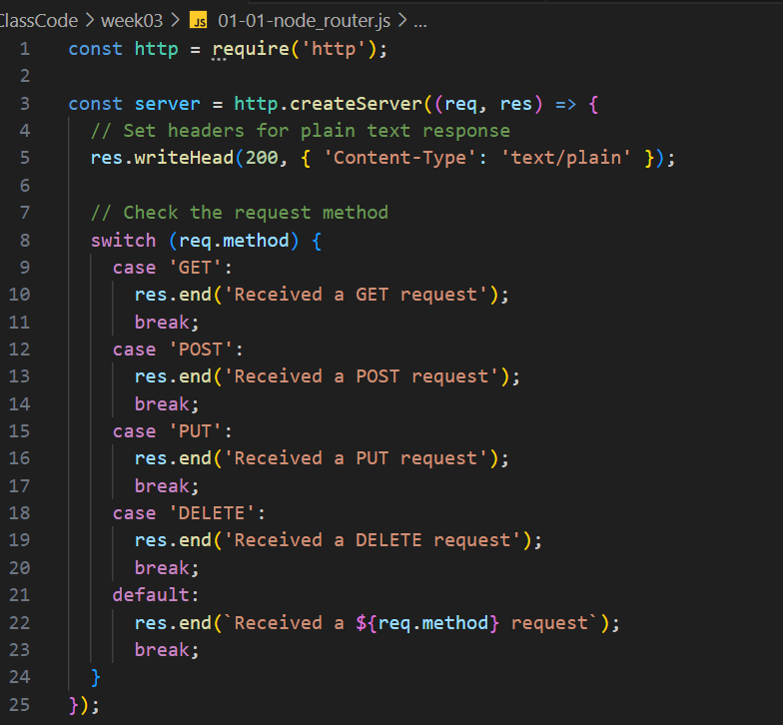
Larger Example

Slide 15
Let's build an Express server
I want 3 routes for now
/
When a user gets to here, we send them a webpage for home.html
/about
When someone gets t here, we send data in json
/login
We have 2 conditions here
When they come here, we send them a web FORM (GET)
When we receive the form, we print the data to our console (POST)

Slide 16
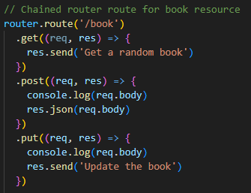
Route Chaining
Can create chainable routes for different request methods to reduce redundancy

Slide 17
Part 1 Complete
You have made a small express server by this point
Next topic: how do we manage URL routing and how does it affect our server
“youtube search: “how to tie a tie”
Whats the URL like?
What about ebay and sites like that?

Slide 18
Part 2: Params and Query -> Dynamic Routing
These are direct ways for users/clients to interact with our server -> Through the URL bar
(Remember Ebay and Youtube)
Using Express, we can send data using route:
send the data in the url
req.params (using the ‘:’)
Example: ebay.ca/itm/:item_id
send the data in the query string.
req.query (?) is an object containing a property for each query string parameter in the route.
Example: youtube.com/watch?v=video_id

Slide 19
Req.params
Example:
Route path: /users/:userId/books/:bookId – Request URL:
http://localhost:3000/users/34/books/8989
Output:
req.params: { "userId": "34", "bookId": "8989" }
The captured values are populated in the req.params object, with the name of the route parameter specified in the path as their respective keys.

Slide 20

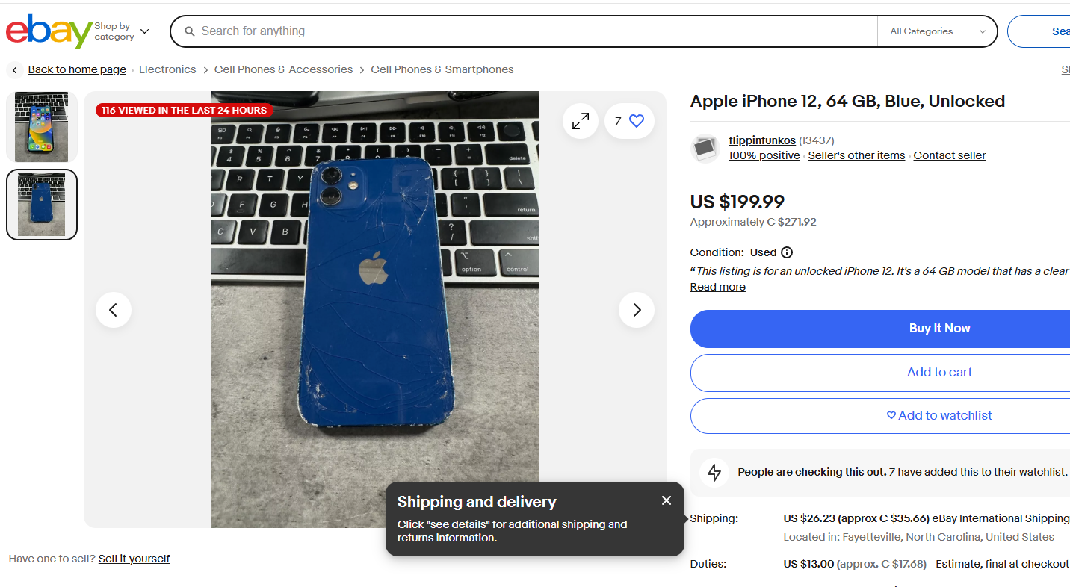
Req.params example
After the domain, we have an endpoint:
/itm/278823441025
What happens if we change the number
What if we remove the number?
Here is a case of parameter based url encoding

Slide 21
Req.query
req.query is an object containing a property for each query string parameter in the route.
//Query String Route :
localhost:8000/api/posts/?bookID=101
app.get('/api/posts/', (req,res) =>{
res.send(req.query);
});

Slide 22

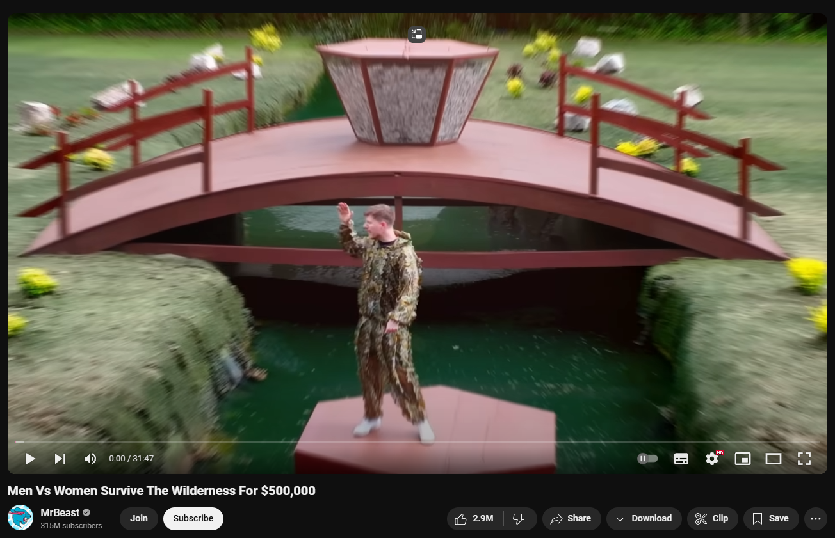
Req.query example
https://www.youtube.com/watch?v=aRcUVhVlSHg&ab_channel=MrBeast
What about searching:
https://www.youtube.com/results?search_query=mr+beast
What if we remove the search term https://www.youtube.com/results?search_query=

Slide 23
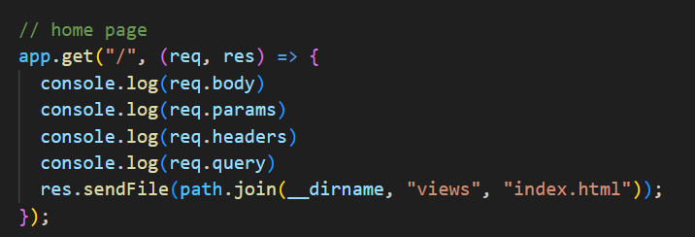
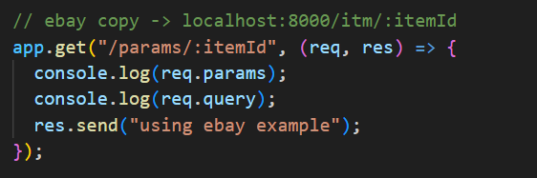
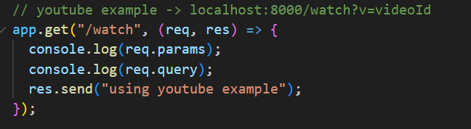
Let's try making something similar in our server
How to call params and query
Let's try this
What about req.body? What happens?
Let's try this

Slide 24
Part 3: Processing Special characters
Did you notice that the youtube video search result replaced the spaces with ‘+’
BUT WHY

Slide 25
Routing can process special characters
“The characters ?, +, *, and () are subsets of their regular expression counterparts. The hyphen (-) and the dot (.) are interpreted literally by string-based paths.”
Essentially, characters like ?, + and * do not get passed along the same way on your url bar the same way
? Has been assigned to query searching so what do we do there?
What about the + sign
Showcase an example from youtube and focus on the URL
Search: how to tie a tie
What is the resulting URL
More examples: https://expressjs.com/en/guide/routing.html
(we will do this for a little bit in our lab)

Slide 26
How do we translate the special signs?
Express has a built-in translator: urlendcoded, but by default, it isn’t enabled
This is a built-in middleware function in Express. It parses incoming requests with urlencoded payloads
A new body object containing the parsed data is populated on the request object after the middleware (i.e. req.body)
This object will contain key-value pairs, where the value can be a string or array (when extended is false), or any type (when extended is true).
Note As req.body’s shape is based on user-controlled input, all properties and values in this object are untrusted and should be validated before trusting

Slide 27
Additional References
Remember this: FormData with React Hooks and Fetch | mattboldt.com
More info:
https://expressjs.com/en/api.html#express.urlencoded
javascript - What are express.json() and express.urlencoded()? - Stack Overflow
Express express.urlencoded() Function - GeeksforGeeks

Slide 28
Part 3: How do we process forms?

Slide 29
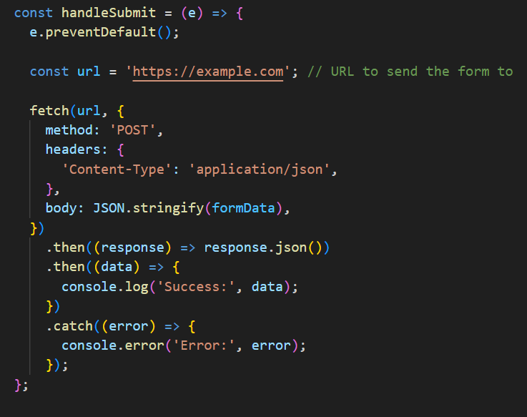
Do you remember this/ did you do this?
In your React classes did you ever send out a form
Maybe something like fetch(link), and sent it with method POST

Slide 30
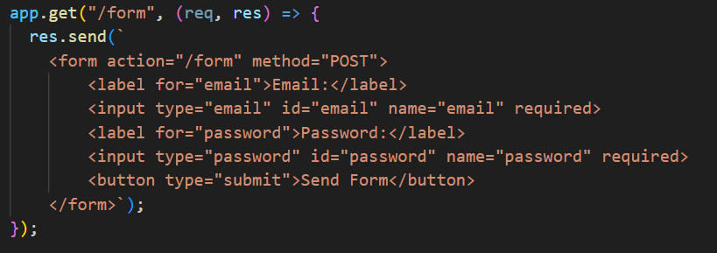
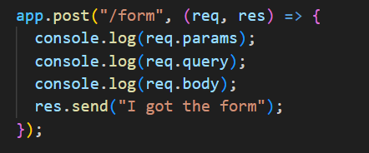
Well, how do I receive it?
Here is a quick example for using get and post
GET -> send a FORM
POST -> receive data from the FORM

Slide 31
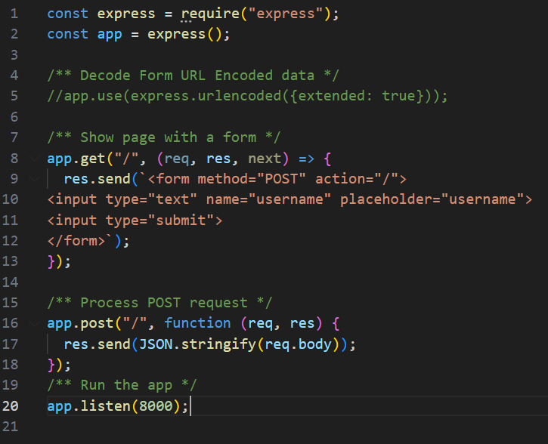
Example of urlencoded being used

Slide 32
This is the old way, the ChatGPT way
There is something called Body Parser
It is meant to be used in your node server to do the same operation as express urlencoded.
Express came after, so Body parser is the older one.
The express developers realized that allot of people used body parser and considered adding it into express to save other developers from having to keep adding more dependencies
Note: I said chatgpt because if you use it to do the work, it will give you body parser

Slide 33
Let's talk about the Response Object

Slide 34

Response Methods
Must send a response to the client or terminate the request cycle or the client will be left hanging waiting for the response
res.send(): Send a response of various types
res.end(): End the response process
res.download(): Prompt user to download a file
res.json(): Send a json response
res.redirect(): Redirect a request
res.render(): Render a view template
(The client waiting)

Slide 35
Based on everything we have talked about think about this?
Let's say we go and build a large web server
How many routes do we make before our file becomes too large
Let's talk about it
What I'm trying to get at: Eventually we will realize we have multiple routes that follow a similar flow, so we can separate the endpoints into different files called routers to handle a curated list of endpoints

Slide 36
PostMan
How do we access the other methods when our browser doesn’t just get us there right away (what I mean is, our browsers default to GET calls)
Postman is a tool used by developers to see and handle requests and record data on what's happened while using it
It is an important tool for anyone going into backend web development
Let's do some testing, I will leave some things for homework
Postman API Platform | Sign Up for Free

Slide 37
One Last thing
You have a test next week
It will be based on everything we have gone through
Lecture 1, 2, 3
Lab 1, lab 2

Slide 38
Next Week: Middleware
Middleware – Anything you do AFTER the server receives the request and BEFORE sending a response
(might be a test question)

Slide 39

Express Middleware
Express is a routing and middleware web framework
Middleware functions are functions that have access to the request and response objects and the next function
An Express application is essentially a series of middleware calls.
The next middleware function is commonly denoted as next
Middleware can make changes to request and response objects, end the request cycle, and call the next middleware

Slide 40
Middleware in Express
We have broken down our work into 2 steps
1 – We receive a request
2 - We eventually sent back a response
Middleware: “Any code that we run after receiving a request and before sending a response”
Code that happens in the middle
Next slide: the login example with amazon

Slide 41
Logging into Amazon
Client: Send login credentials (email, password)
Server: receives the request
Server: sends a response back
Client: gets login confirmation from the response

Slide 42
Let's break it down a bit more
Client: Send login credentials (email, password)
Server: receives the request
Middleware:
Breakdown and parse credentials
Check database for an account with that email
Decode and compare the passwords
Maybe do some 2FA
Server: sends a response back
Client: gets login confirmation from the response

Slide 43
Middleware in Express
Looking back at the other example, since we make new functions to handle each of the middleware options we need to consider this
Middleware:
Breakdown and parse credentials
Check database for an account with that email
Decode and compare the passwords
Maybe do some 2FA
Each of those need to be done step by step, but we also need to tell out code when to move to the next step. (The key word here is next)

Slide 44
We will investigate its next class, but…
Here is a small example:
Logger
When a user accesses our server, write into our console what they accessed
Seems simple enough. I’ll even ask ChatGPT for the code. (but realistically, I'm doing this just to showcase on I’m using it on a smaller scale to help my program, not take over my program)

Slide 45
Lecture portion is complete
Next up
Working on the bookstore
Convert it to an express server
Working on Lab 2

